Slide 1
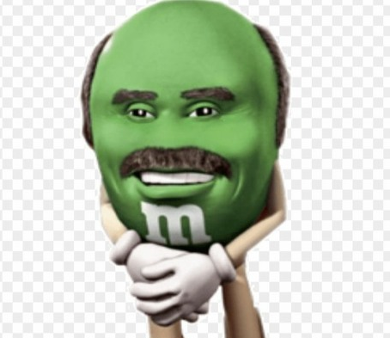
Project: Pizzeria
Johnson Domacasse
Daan Spronk
Dimitar Georgiev

Slide 2
Demo

Slide 3
Problems and improvements
#1: Database
#2: Arduino

Slide 4
Why us?
Why our product?
Why purchase our product?
What are its key defining features?

Slide 5
Reflection.
What went well?
What didn’t go well and why?
What would we do different?

Slide 6
QUESTIONS?

